Slide 1

Text Data Clustering
LLM embeddings (OpenAI, BERT) vs TF-IDF embedding
GROUP-16
Bhanu Prakash Ramineni Damini Madhurika Manjunatha
Narendar Pillalamarri Sahithi Reddy Maryada

Slide 2
Contents
Introduction to Text Clustering
Preprocessing, Embeddings, Clustering Algorithms
Dataset: 20 Newsgroups
Evaluation & Visualizations
Research Context: Petukhova et al. (2023)
Results — Comparison
Methodology Overview
Contributions
01
05
02
06
03
07
04
08

Slide 3
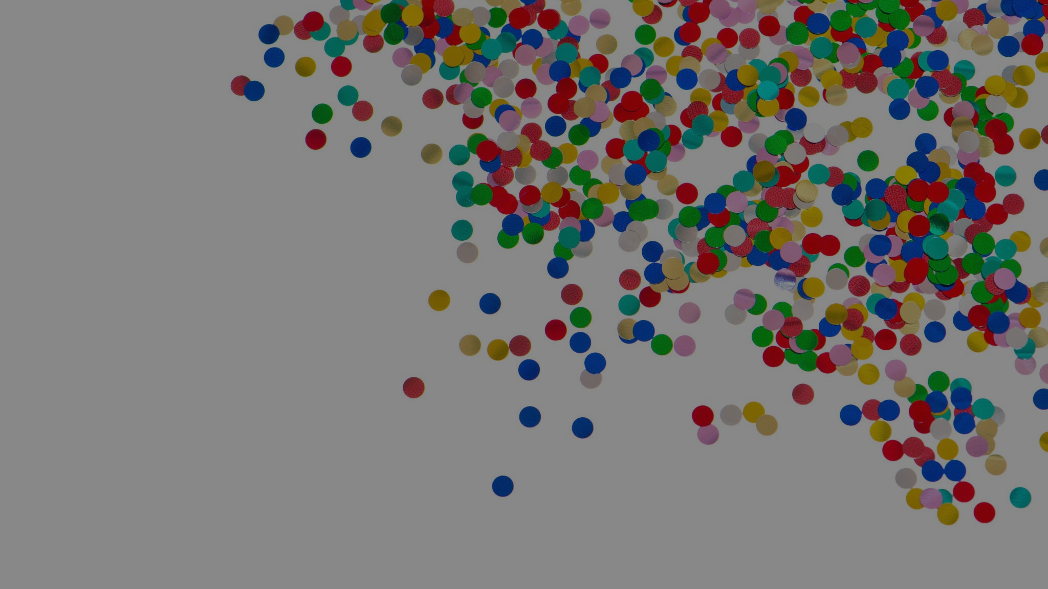
What is Text Clustering
Unsupervised machine learning task
Automatically groups similar textual documents
Applications include topic modeling, sentiment analysis, and content organization
Challenges: dimensionality, semantics, computational efficiency

Slide 4
Dataset Overview: 20 Newsgroups
18,846 documents from 20 distinct categories
Categories include topics like atheism, computers, medicine, politics, science, religion
Rich source for evaluating clustering algorithms
Requires robust preprocessing due to noisy data

Slide 5
Research Context- Petukhova et al. (2023)
Analyzed various embeddings (OpenAI, BERT, Falcon, LLaMA-2)
Findings:
OpenAI embeddings offer superior performance for structured data
BERT provides strong open-source alternative
Embedding dimensionality impacts clustering effectiveness

Slide 6
Methodology Overview
Dataset loading
Text preprocessing
Embeddings generation (TF-IDF, OpenAI, BERT)
Clustering Algorithms (K-Means, Agglomerative Hierarchical)
Evaluation using ARI, HS, SS, F1-Score
Visualization using PCA, t-SNE

Slide 7
Text Preprocessing Steps
Convert text to lowercase
Remove non-alphabetic characters
Eliminate stopwords
Ensure uniformity and reduce noise
Example of Preprocessing:
Raw: "I'm buying a 1995 Honda Civic. Advice?"
Processed: "buying honda civic advice"
Simplifies analysis, removes irrelevant features

Slide 8
Text Embedding: TF-IDF
Term Frequency-Inverse Document Frequency
Captures lexical importance, not semantics
Parameters: max_df=0.95, min_df=5, max_features=8000
Sparse matrix representation for computational efficiency

Slide 9
Text Embedding: OpenAI Embeddings
Model: text-embedding-ada-002
1536-dimensional embeddings capturing nuanced semantics
Best performance in paper’s findings (F1: 0.69)
Computational cost higher but captures deeper semantic structure

Slide 10
Text Embedding: BERT Embeddings
Model: all-MiniLM-L6-v2
384-dimensional embeddings
Balanced efficiency and semantic capturing capability
Competitive performance (F1: 0.43)

Slide 11
Clustering Algorithm: K-Means
Partitions data into K clusters minimizing intra-cluster variance
Parameters: n_clusters=20, random_state=42
Robust and computationally efficient
Frequently used benchmark algorithm

Slide 12
Clustering Algorithm: Agglomerative Hierarchical
Bottom-up approach merging similar clusters progressively
Parameters: n_clusters=20, Ward linkage
Captures hierarchical structures, suitable for nuanced data relationships
More computationally intensive than K-Means

Slide 13
Evaluation Metrics Overview
External Metrics:
Adjusted Rand Index (ARI)
Homogeneity Score (HS)
Macro F1 Score (F1S)
Internal Metrics: Silhouette Score (SS): cluster cohesion vs separation

Slide 14
Visualization Techniques: PCA
Linear dimensionality reduction to 2 dimensions
Projects data onto principal components
Visualizes global clustering structure

Slide 15
Visualization Techniques: t-SNE
Non-linear dimensionality reduction
Parameters: perplexity=30, n_iter=1000
Captures local clustering structure effectively

Slide 16
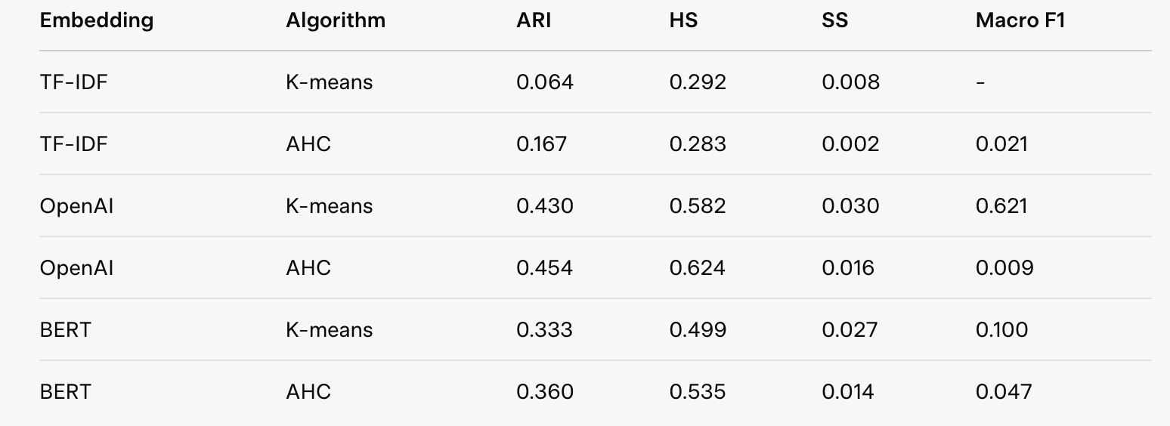
Clustering Results
OpenAI + AHC achieves highest ARI (0.454) and HS (0.624), but low Macro F1 (0.009)
OpenAI + K-means excels in Macro F1 (0.621), indicating strong precision-recall balance
BERT outperforms TF-IDF across all metrics, with AHC slightly better than K-means
TF-IDF shows poorest performance, especially with K-means (ARI: 0.064)

Slide 17
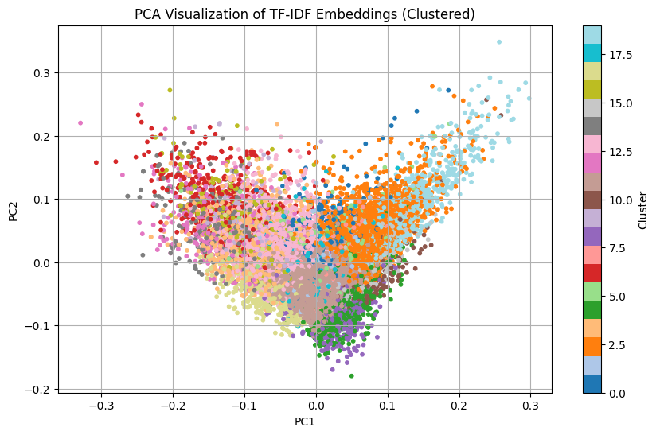
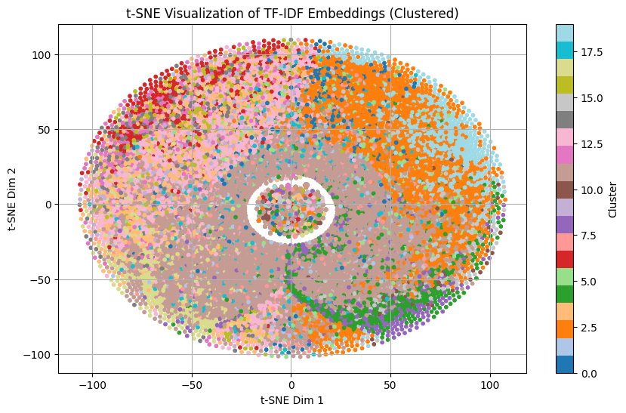
TF-IDF Visualization (K-means)

Slide 18
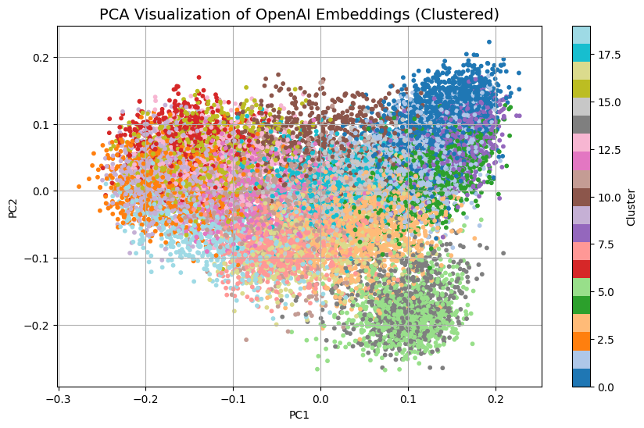
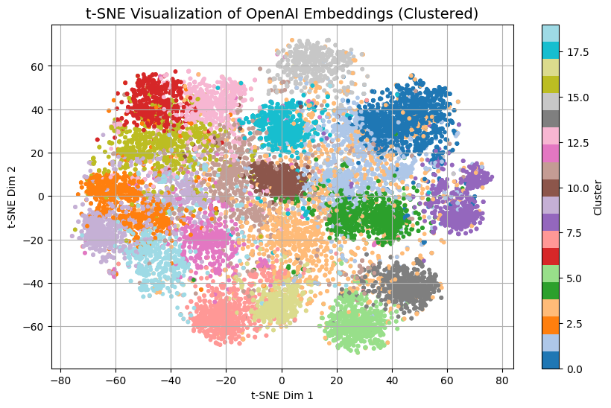
OpenAI Embeddings Visualization (K-means)

Slide 19
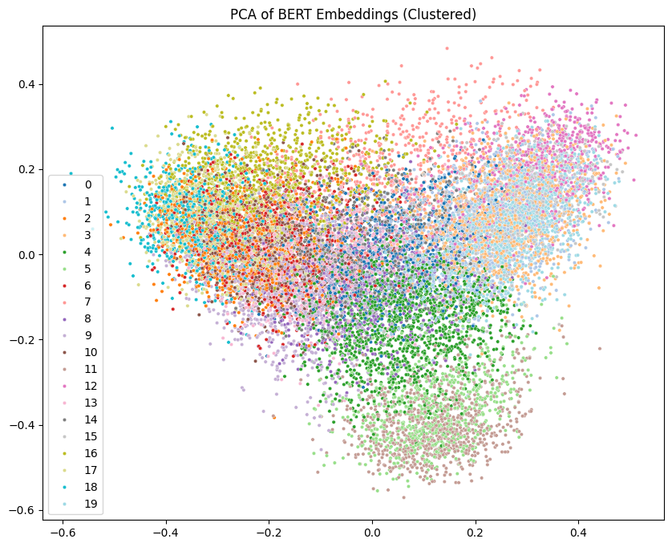
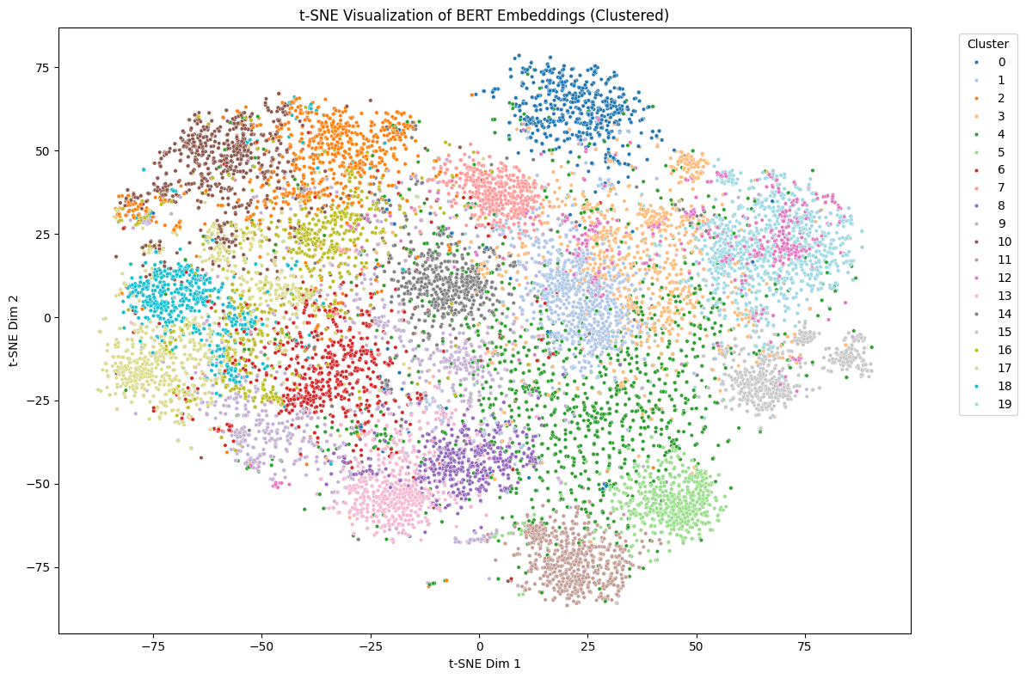
BERT Embeddings Visualization (K-means)

Slide 20
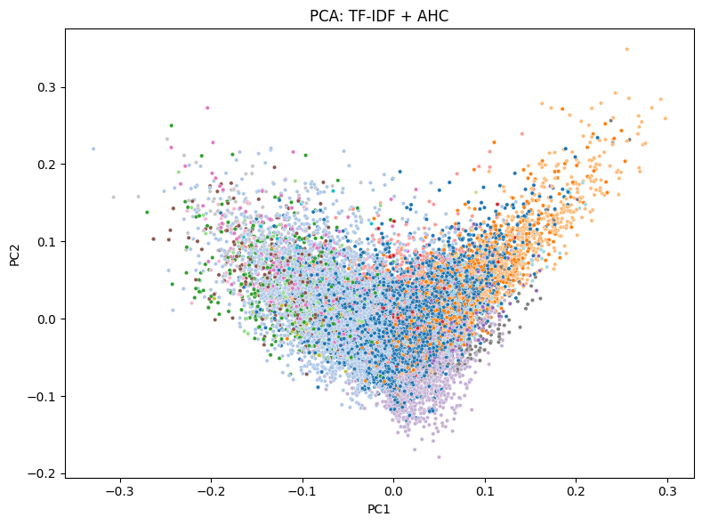
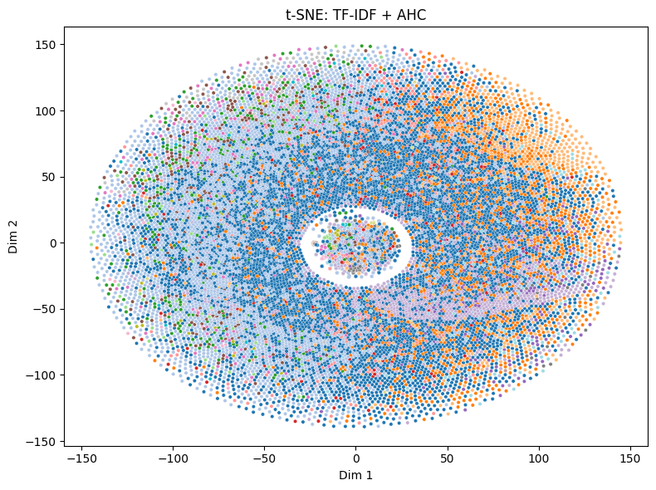
TF-IDF Visualization (AHC)

Slide 21
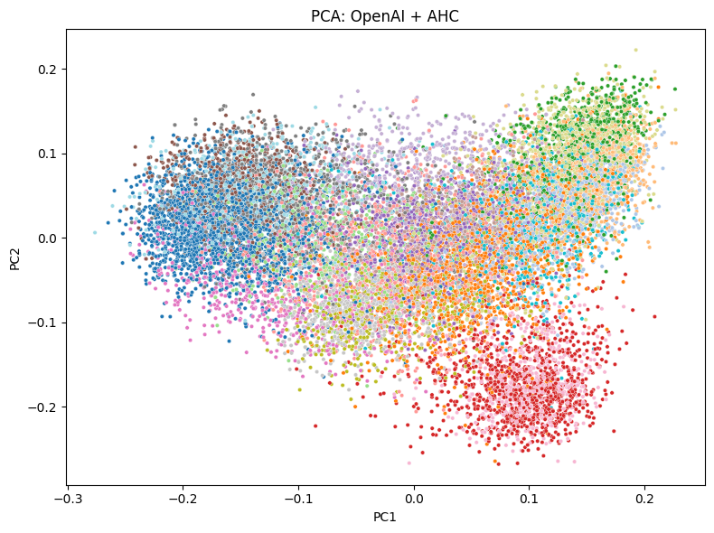
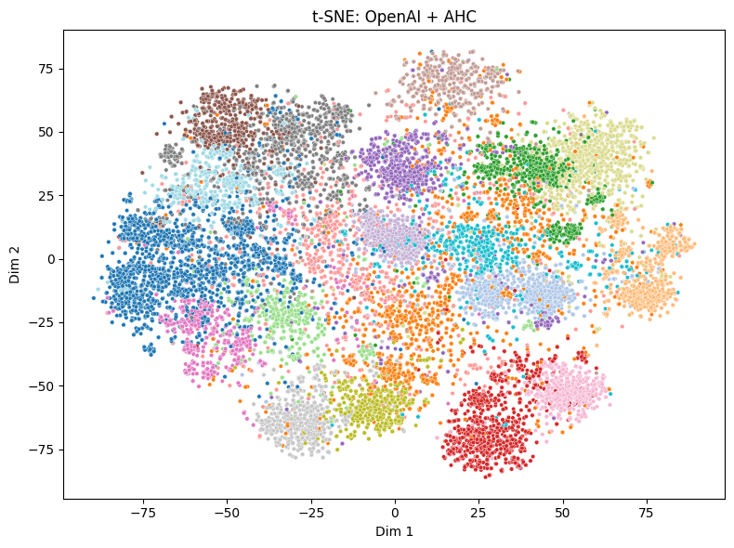
OpenAI Embeddings Visualization (AHC)

Slide 22
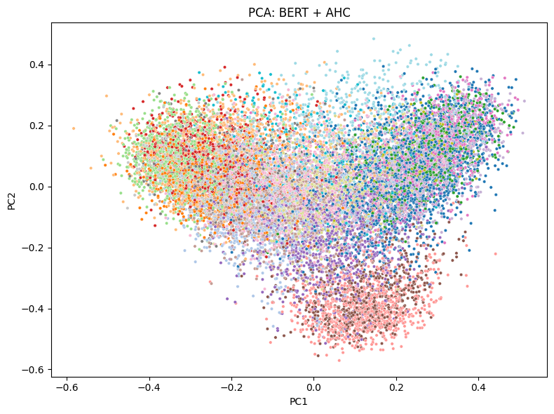
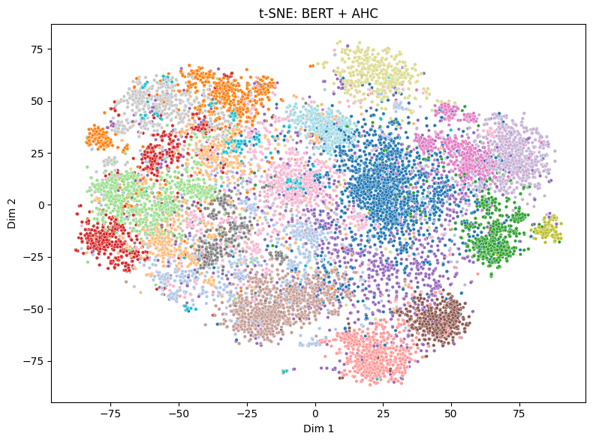
BERT Embeddings Visualization (AHC)

Slide 23
Comparative Analysis
OpenAI embeddings dominate performance: Highest ARI (0.454, AHC) and HS (0.624, AHC), with K-means achieving superior Macro F1 (0.621)
BERT balances efficiency and accuracy: Moderate ARI (0.360, AHC) and HS (0.535, AHC) with lower computational cost than OpenAI, making it a strong open-source choice for resource-constrained settings.
TF-IDF baseline underscores semantic limitations: Lowest ARI (0.064, K-means) and SS (0.002, AHC), confirming the need for contextual embeddings to capture nuanced text relationships.
Paper’s findings align with code results.

Slide 24
Key Insights from Petukhova et al. (2023)
Summarization typically reduces clustering performance
Larger embedding dimensions improve results but at computational expense
Falcon, LLaMA-2 embeddings showed lower performance compared to OpenAI

Slide 25
Conclusions and Future Directions
OpenAI embeddings excel for nuanced text clustering
BERT embeddings suitable for resource-limited environments
TF-IDF useful as a quick, interpretable baseline
Future research:
Experimenting with summarization prompts
Exploring larger, computationally feasible models
Extending analysis to varied datasets and contexts

Slide 26
Individual Contributions
Bhanu Prakash Ramineni and Narendar Pillalamarri
Data Preprocessing
TF-IDF Embeddings & K-means Clustering
OpenAI Embeddings, Clustering & Evaluation
Sahithi Maryada and Damini Madhurika
BERT Embeddings, Agglomerative Hierarchical Clustering (AHC) for three embeddings, and Evaluation
PPT Slides preparation

